Slide 1

David M. Kroenke and David J. Auer Database Processing Fundamentals, Design, and Implementation
Chapter Six:
Transforming Data Models
into
Database Designs

Slide 2
Chapter Objectives
To understand how to transform data models into database designs
To be able to identify primary keys and understand when to use a surrogate key
To understand the use of referential integrity constraints
To understand the use of referential integrity actions
To be able to represent ID-dependent, 1:1, 1:N, and N:M relationships as tables
To be able to represent weak entities as tables

Slide 3
Chapter Objectives
To be able to represent supertypes/subtypes as tables
To be able to represent recursive relationships as tables
To be able to represent ternary relationships as tables
To be able to implement referential integrity actions required by minimum cardinalities

Slide 4
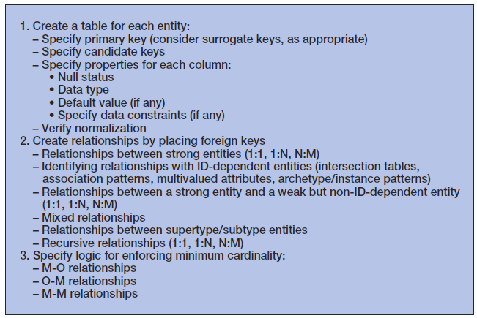
Steps for Transforming a Data Model into a Database Design

Slide 5
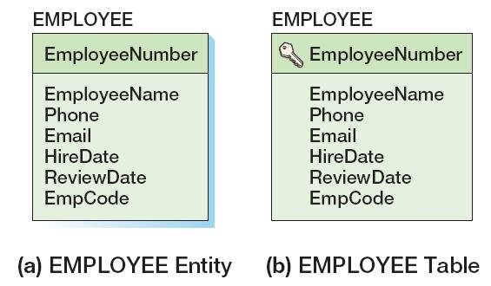
Create a Table for Each Entity
EMPLOYEE (EmployeeNumber, EmployeeName, Phone, Email, HireDate, ReviewDate, EmpCode)
Primary key is designated by the key symbol
Note shadowless table
Notes:
음영을 넣고 넣지 않고는 이 책에서의 표기. 일반화된 표기는 아님에 유의.

Slide 6
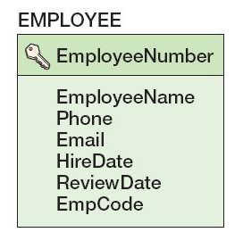
Select the Primary Key
The ideal primary key is short, numeric, and fixed.
Surrogate keys meet the ideal, but have no meaning to users.

Slide 7
Specify Candidate (Alternate) Keys
The terms candidate key and alternate key are synonymous.
Candidate keys are alternate identifiers of unique rows in a table.
Will use AKn.m notation, where n is the number of the alternate key, and m is the column number in that alternate key.
Notes:
Alternate key: 대체키로 번역

Slide 8
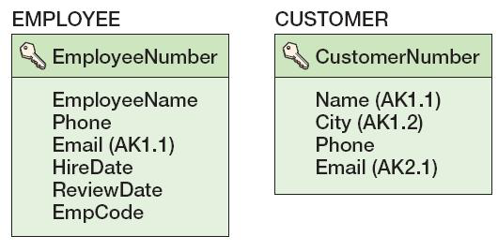
Specify Candidate (Alternate) Keys

Slide 9
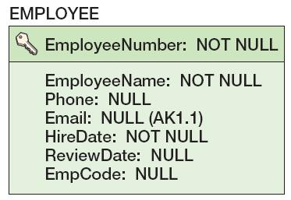
Specify Column Properties: Null Status
Null status indicates whether or not the value of the column can be NULL.

Slide 10
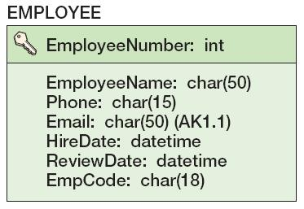
Specify Column Properties: Data Type
Generic data types:
CHAR(n)
VARCHAR(n)
DATE
TIME
MONEY
INTEGER
DECIMAL

Slide 11
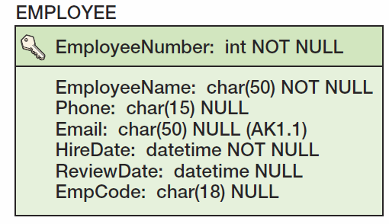
Specify Column Properties: Data Type + Null Status

Slide 12
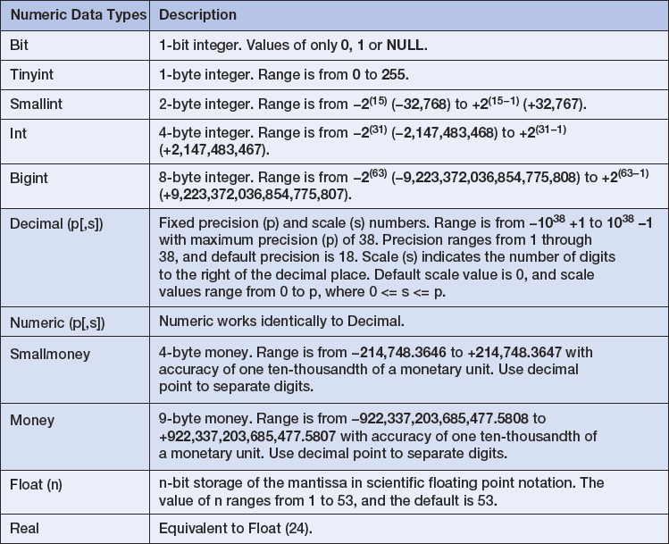
Specify Column Properties: SQL Server 2012 Data Types I

Slide 13
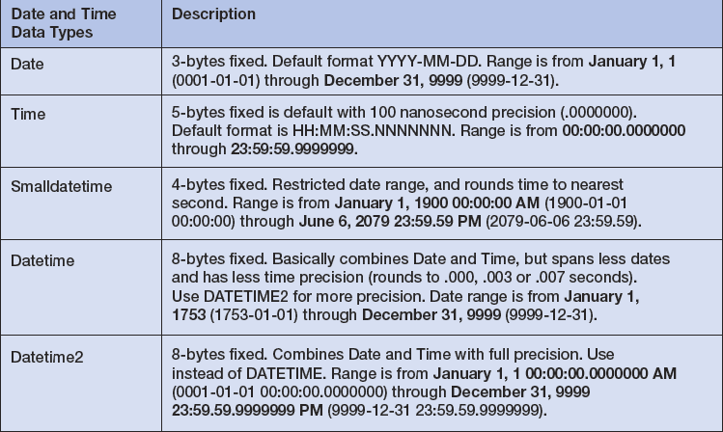
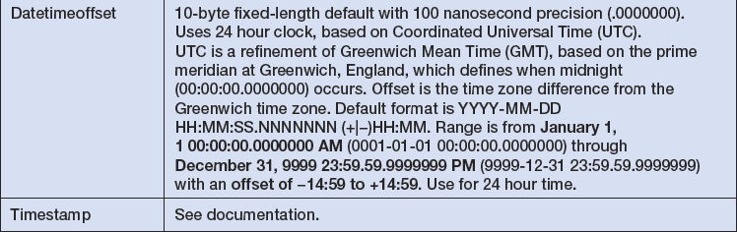
Specify Column Properties: SQL Server 2012 Data Types II

Slide 14
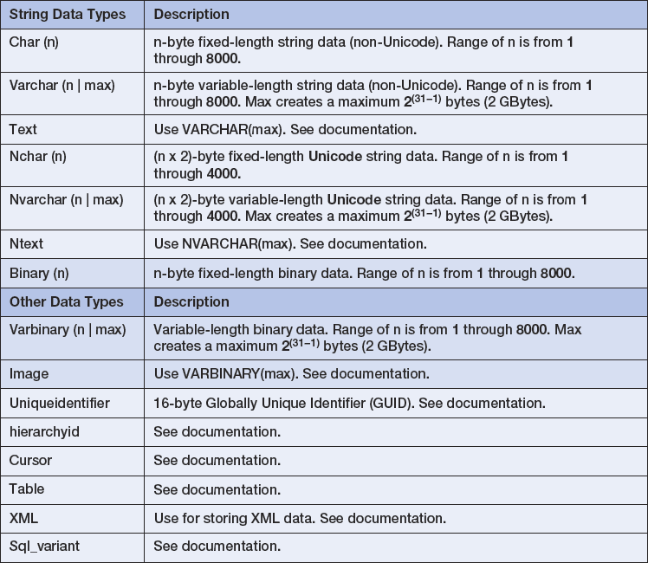
Specify Column Properties: SQL Server 2012 Data Types III

Slide 15
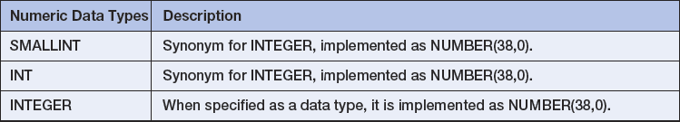
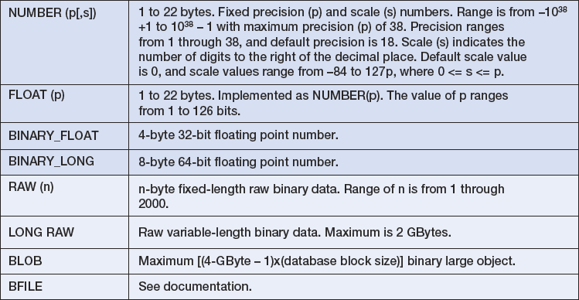
Specify Column Properties: Oracle Database 11g Release 2 Data Types I

Slide 16
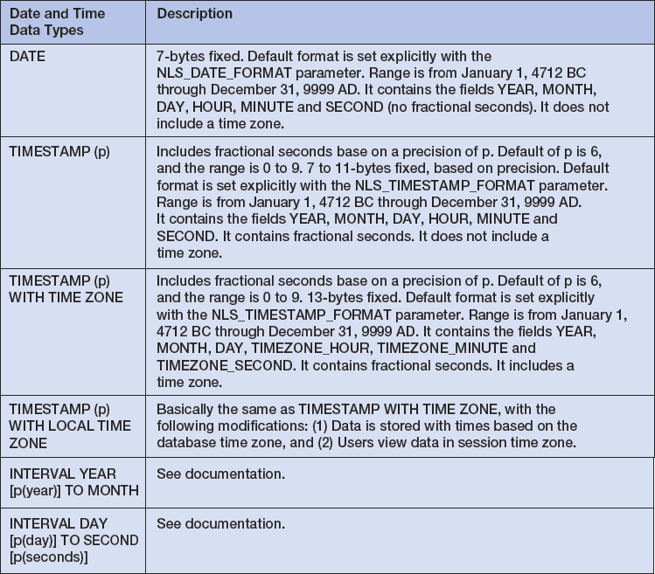
Specify Column Properties: Oracle Database 11g Release 2 Data Types II

Slide 17
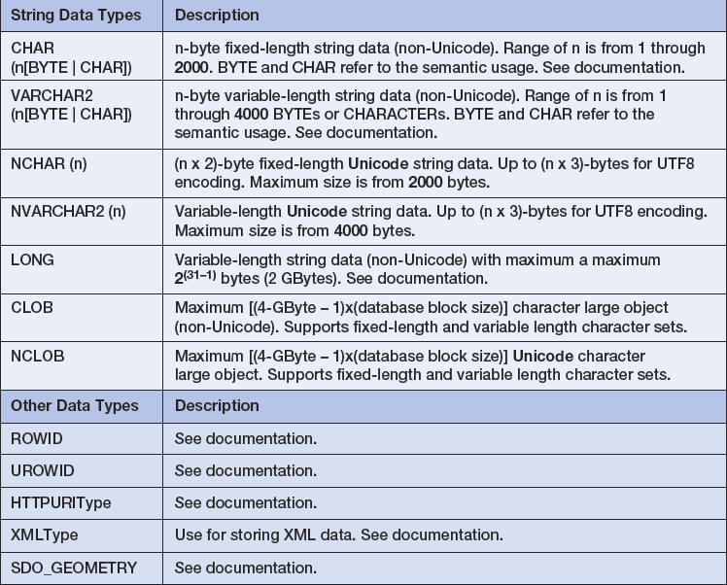
Specify Column Properties: Oracle Database 11g Release 2 Data Types III

Slide 18
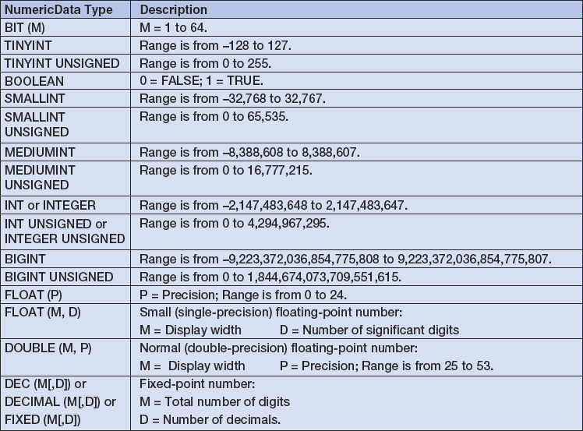
Specify Column Properties: MySQL 5.6 Data Types I

Slide 19
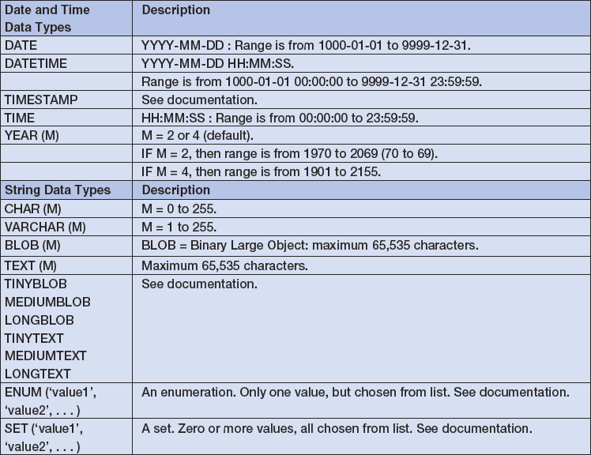
Specify Column Properties: MySQL 5.6 Data Types II

Slide 20
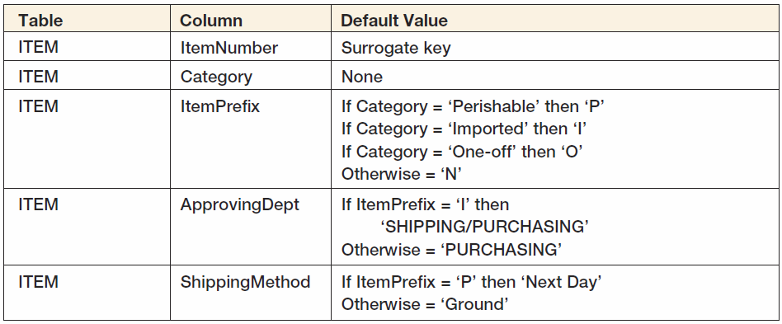
Specify Column Properties: Default Value
A default value is the value supplied by the DBMS when a new row is created.

Slide 21
Specify Column Properties: Data Constraints
Data constraints are limitations on data values:
Domain constraint—column values must be in a given set of specific values.
Range constraint—column values must be within a given range of values.
Intrarelation constraint—column values are limited by comparison to values in other columns in the same table.
Interrelation constraint—column values are limited by comparison to values in other columns in other tables (referential integrity constraints on foreign keys).

Slide 22
Verify Normalization
The tables should be normalized based on the data model.
Verify that all tables are:
BCNF
4NF

Slide 23
Create Relationships: 1:1 Strong Entity Relationships
Place the key of one entity in the other entity as a foreign key.
Either design will work—no parent, no child
Minimum cardinality considerations may be important.
O-M will require a different design than M-O.
One design will be very preferable.

Slide 24
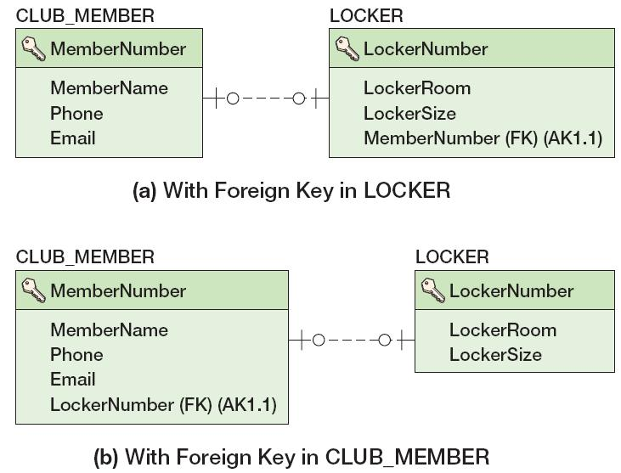
Create Relationships: 1:1 Strong Entity Relationships
Notes:
FK가 AK(1,1)로 표현됨에 주의. 1-1이기에 가능.

Slide 25
Create Relationships: 1:N Strong Entity Relationships
Place the primary key of the table on the one side of the relationship into the table on the many side of the relationship as the foreign key.
The one side is the parent table and the many side is the child table, so “place the key of the parent in the child.”

Slide 26
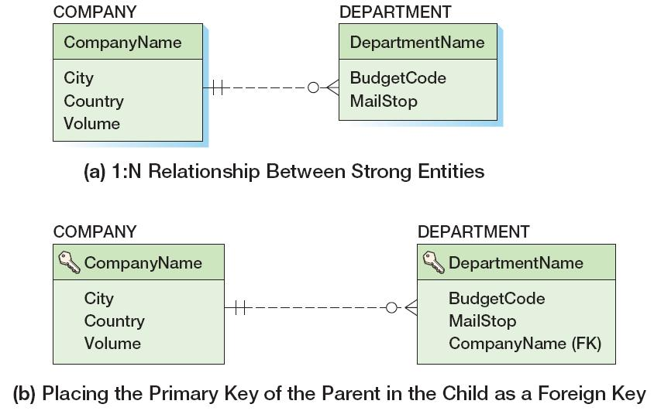
Create Relationships: 1:N Strong Entity Relationships

Slide 27
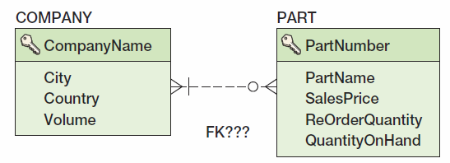
Create Relationships: N:M Strong Entity Relationships
In an N:M strong entity relationship there is no place for the foreign key in either table.
A COMPANY may supply many PARTs.
A PART may be supplied by many COMPANYs.

Slide 28
Create Relationships: N:M Strong Entity Relationships
The solution is to create an intersection table that stores data about the corresponding rows from each entity.
The intersection table consists only of the primary keys of each table which form a composite primary key.
Each table’s primary key becomes a foreign key linking back to that table.
COMPANY_PART_INT (CompanyName, PartNumber)

Slide 29
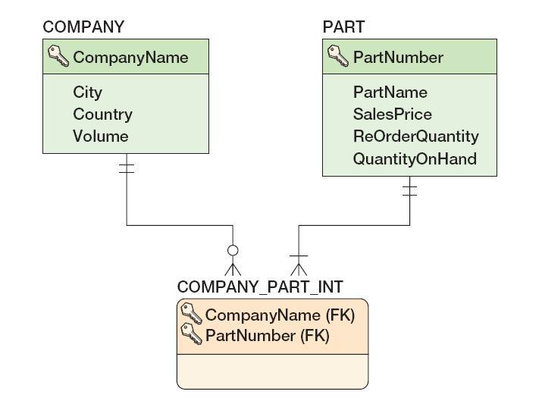
Create Relationships: N:M Strong Entity Relationships
COMPANY_PART_INT (CompanyName, PartNumber)

Slide 30
Relationships Using ID-Dependent Entities: Four Uses for ID-Dependent Entities
Representing N:M Relationships
We just discussed this
Association Relationships
Multivalued Attributes
Archetype/Instance Relationships

Slide 31
Relationships Using ID-Dependent Entities: Association Relationships
An intersection table
Holds the relationships between two strong entities in an N:M relationship
Contains only the primary keys of the two entities:
As a composite primary key
As foreign keys
An association table
Has all the characteristics of an intersection table
PLUS it has one or more columns of attributes specific to the associations of the other two entities

Slide 32
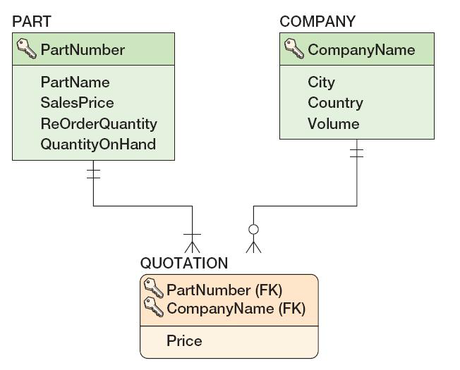
Relationships Using ID-Dependent Entities: Association Relationships
QUOTATION (CompanyName, PartNumber, Price)

Slide 33
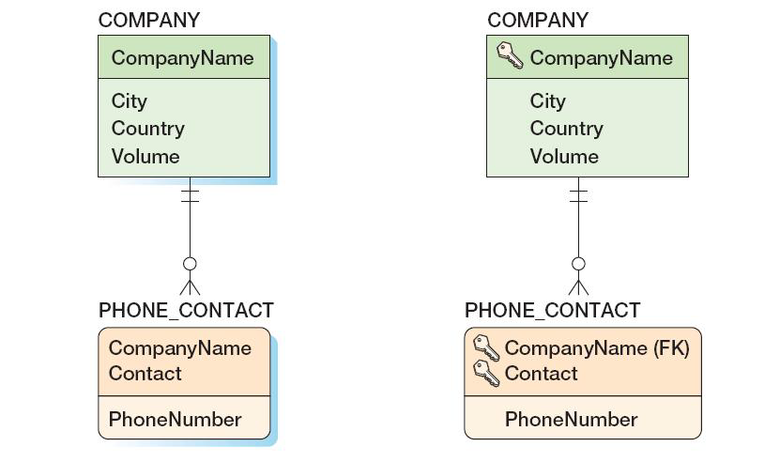
Relationships Using ID-Dependent Entities: Multivalued Attributes
As a data model
As a database design

Slide 34
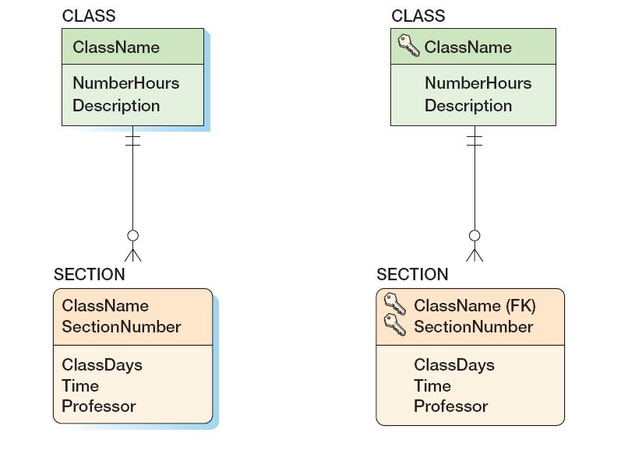
Relationships Using ID-Dependent Entities: Archetype/Instance Pattern
As a data model
As a database design

Slide 35
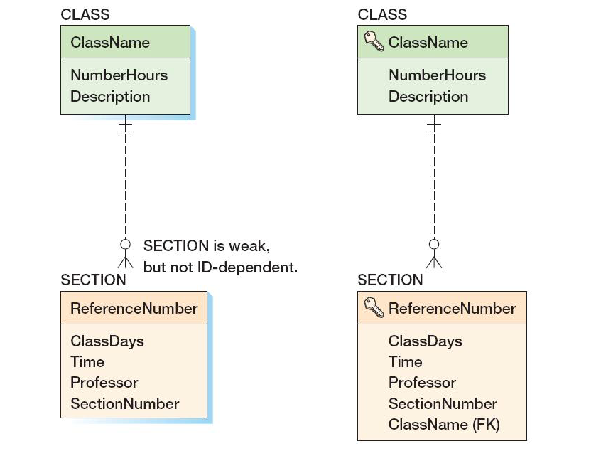
Relationships Using Weak Entities: Archetype/Instance Pattern
As a data model
As a database design

Slide 36
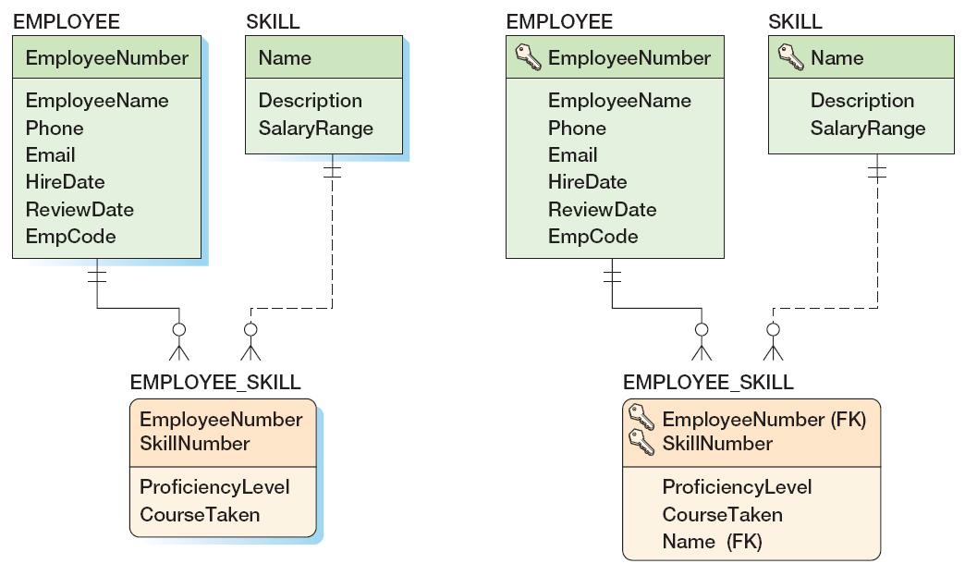
Mixed Entity Relationships
As a data model
As a database design

Slide 37
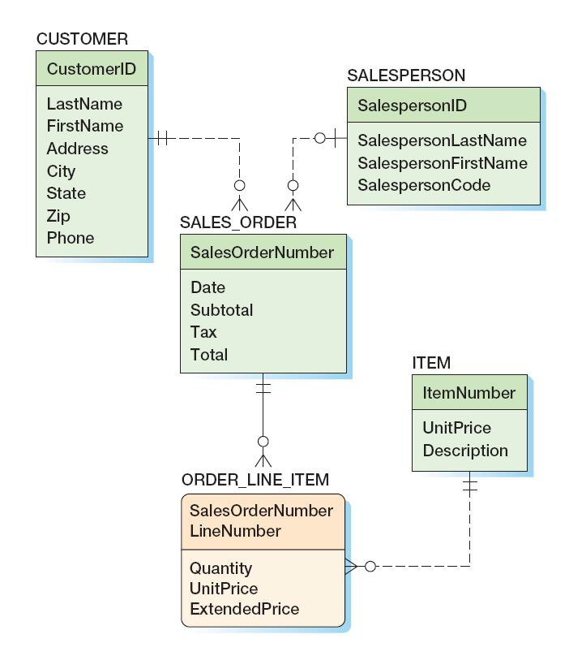
Mixed Entity Relationships: The SALES_ORDER Pattern
As a data model

Slide 38
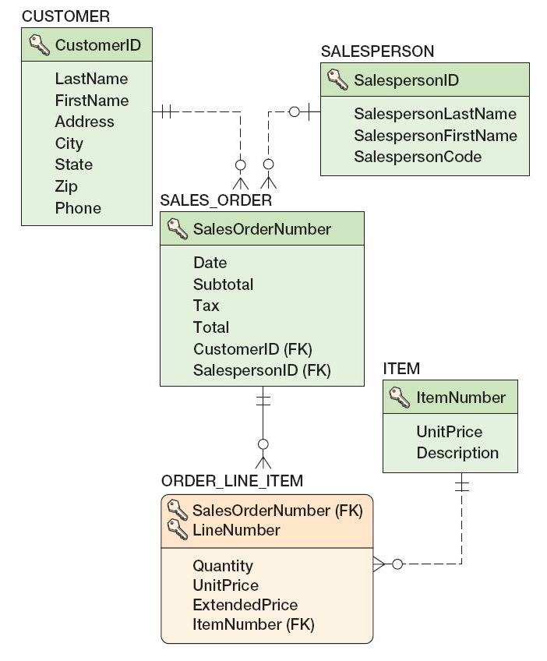
Mixed Entity Relationships: The SALES_ORDER Pattern
As a database design

Slide 39
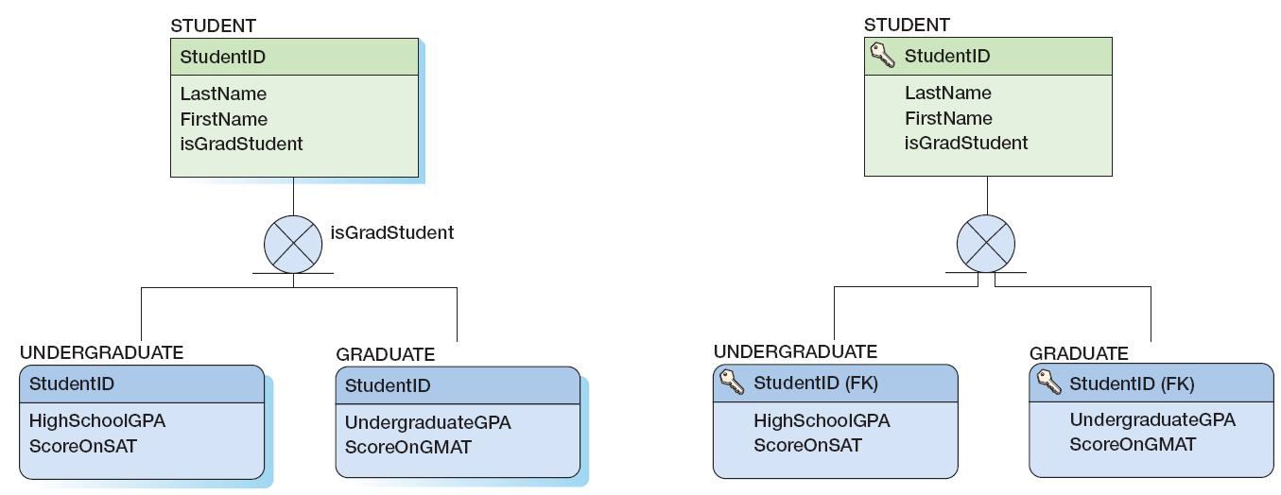
Subtype Relationships
As a data model
As a database design

Slide 40
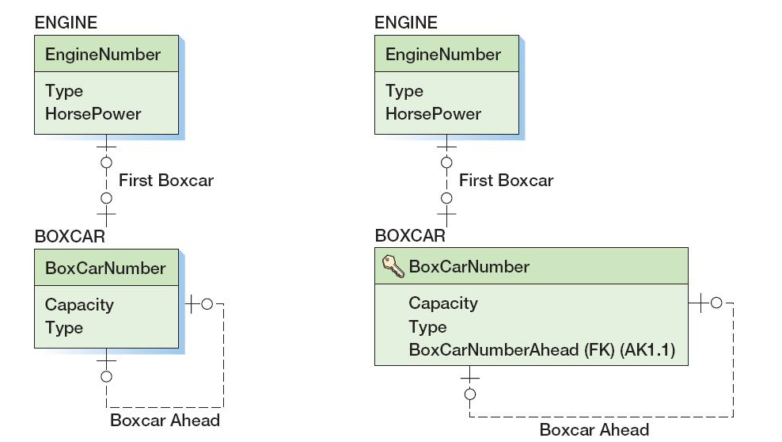
Recursive Relationships: 1:1 Recursive Relationships
As a data model
As a database design

Slide 41
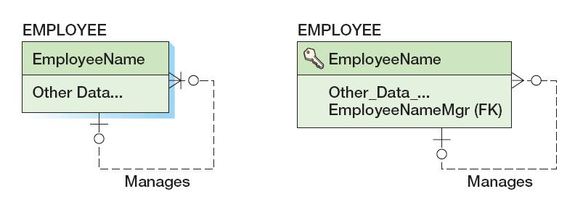
Recursive Relationships: 1:N Recursive Relationships
As a data model
As a database design

Slide 42
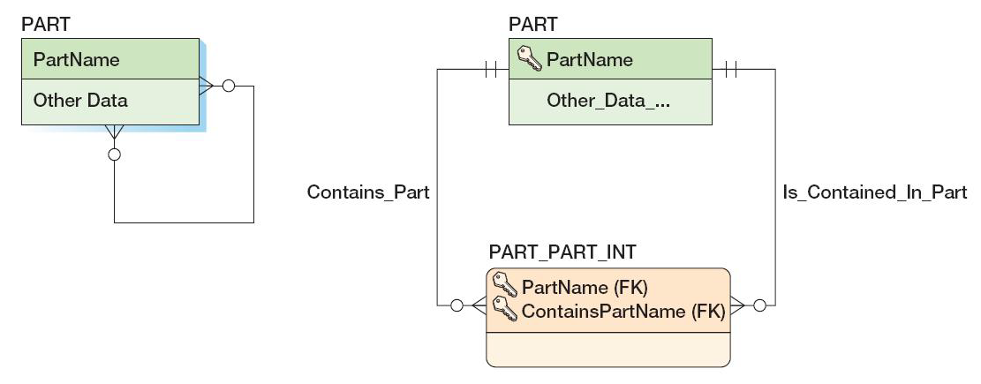
Recursive Relationships: N:M Recursive Relationships
As a data model
As a database design

Slide 43
Representing Ternary and Higher-Order Relationships
Ternary and higher-order relationships may be constrained by the binary relationship that comprise them.
MUST constraint—requires that one entity must be combined with another entity in the ternary (or higher-order) relationship.
MUST NOT constraint—requires that certain combinations of two entities are not allowed to occur in the ternary (or higher-order) relationship.
MUST COVER constraint—a binary relationship specifies all combinations of two entities that must appear in the ternary (or higher-order) relationship.
Notes:
설계 상에서는 불가능: 문서화 필요.

Slide 44
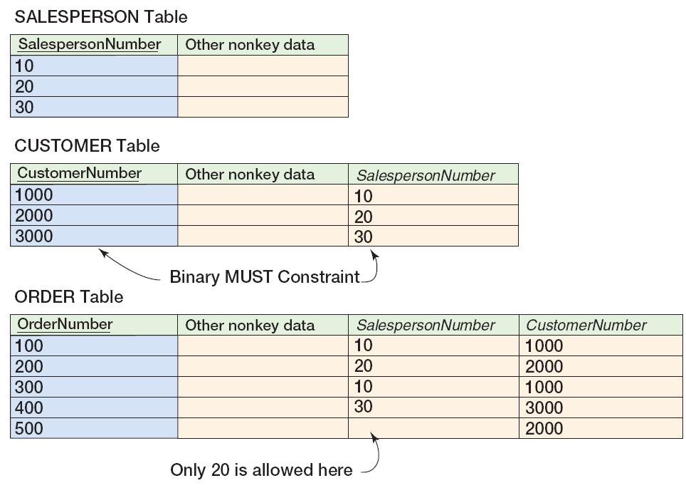
MUST Constraint
Notes:
각 Customer는 지정된 Salesperson을 통해 주문해야만. *** MUST Constraint.
* 위의 조건은 Order 테이블에 Customer와 Salesperson의 조합이 지정됨을 의미.

Slide 45
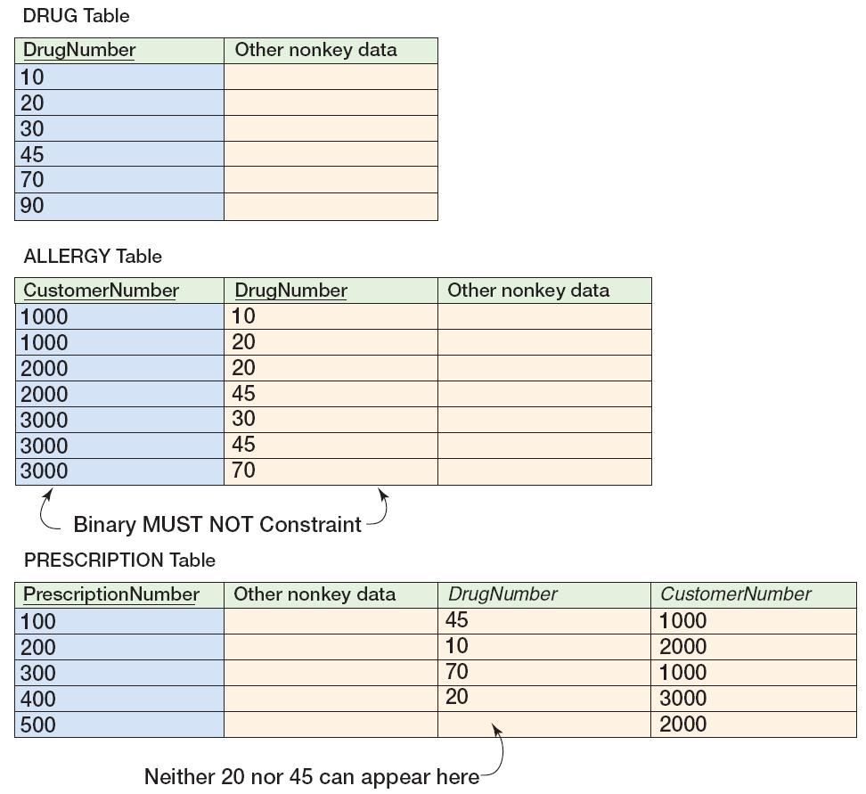
MUST NOT Constraint
Notes:
MUST NOT : Allergy table의 고객과 Drug에 대해 MUST NOT 정보가 제시됨.

Slide 46
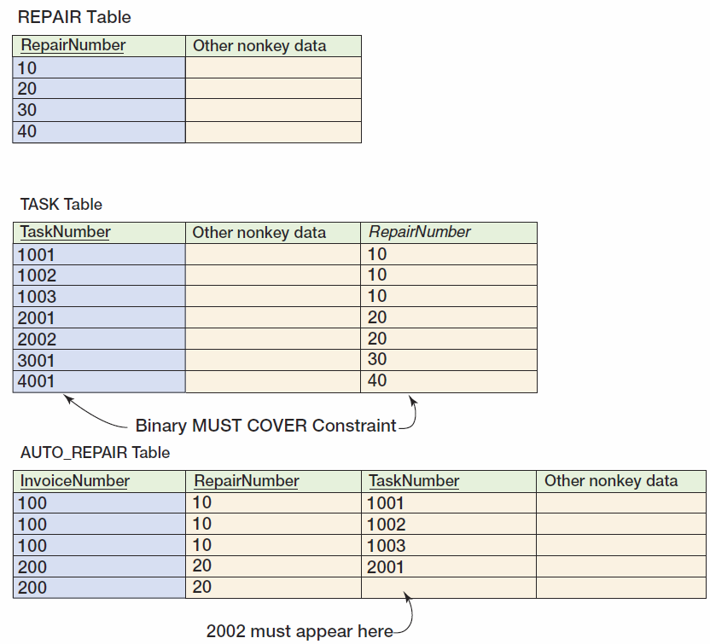
MUST COVER Constraint
Notes:
MUST COVER : Repair는 다수의 Task들로 구성. auto_repair의 경우 repair no는 Cover해야할 Task들이 존재

Slide 47
Design for Minimum Cardinality
Relationships can have the following types of minimum cardinality:
O-O: parent optional and child optional
M-O: parent mandatory and child optional
O-M: parent optional and child mandatory
M-M: parent mandatory and child mandatory
We will use the term action to mean a minimum cardinality enforcement action.
No action needs to be taken for O-O relationships.

Slide 48
Cascading Updates and Deletes
A cascading update occurs when a change to the parent’s primary key is applied to the child’s foreign key.
Surrogate keys never change and there is no need for cascading updates when using them.
A cascading delete occurs when associated child rows are deleted along with the deletion of a parent row.
For strong entities, generally do not cascade deletes
For weak entities, generally do cascade deletes

Slide 49
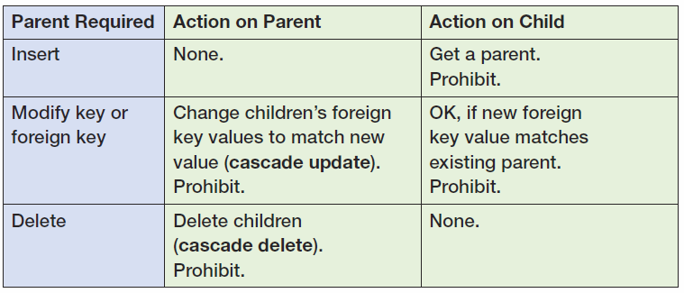
Actions When the Parent Is Required [Figure 6-28(a)]

Slide 50
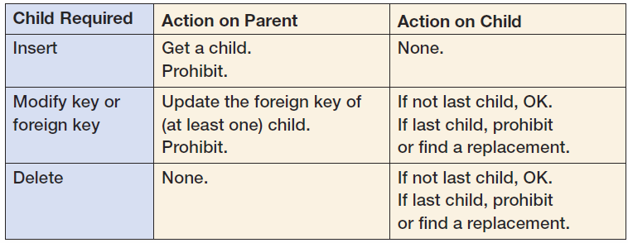
Actions When the Child Is Required [Figure 6-28(b)]

Slide 51
Application Programming: Triggers
Application programming uses SQL embedded in triggers, stored procedures, and other program code to accomplish a specific task.
A trigger is a stored program that is executed by the DBMS whenever a specified event occurs on a specified table or view (defined in Chapter Seven).
Triggers are used to enforce specific minimum cardinality enforcement actions not otherwise programmed into the DBMS.
Triggers will be discussed in detail in Chapters 7, 10 (SQL Server), 10A (Oracle Database),and 10B (MySQL 5.5).

Slide 52
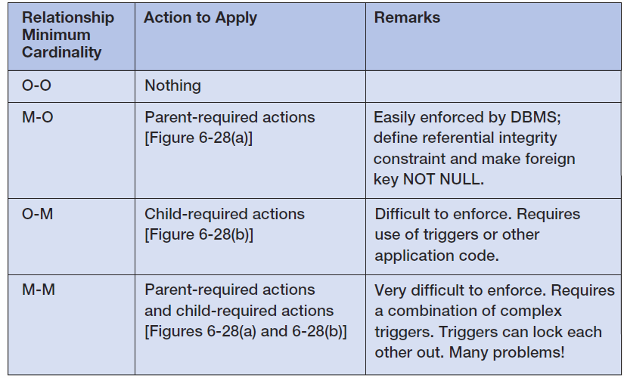
Actions To Apply to Enforce Minimum Cardinality

Slide 53
Implementing Actions for M-O Relationships
See Figure 6-28(a)
Make sure that:
Every child has a parent.
Operations never create orphans.
The DBMS will enforce the action as long as:
Referential integrity constraints are properly defined.
The foreign key column is NOT NULL.

Slide 54
Implementing Actions for O-M Relationships
See Figure 6-28(b)
The DBMS does not provide much help.
Triggers or other application codes will need to be written.

Slide 55
Implementing Actions for M-M Relationships
The worst of all possible worlds:
Especially in strong entity relationships.
In relationships between strong and weak entities the problem is often easier when all transactions are initiated from the strong entity side.
All actions in both Figure 6-28(a) and Figure 6-28(b) must be applied simultaneously.
Complicated and careful application programming will be needed.

Slide 56
Implementing Actions for M-O Relationships: DEPARTMENT and EMPLOYEE
DEPARMENT is parent—EMPLOYEE is child.
Actions on parent:
DEPARTMENT rows can be created.
DEPARTMENT primary key—cascade updates if not surrogate key.
IF a DEPARTMENT is deleted, do we delete the associate EMPLOYEEs?
IF YES—cascade deletes.
IF NO—prohibit associate employees.

Slide 57
Implementing Actions for M-O Relationships: DEPARTMENT and EMPLOYEE
Actions on child
Set referential integrity constraint and set foreign key to NOT NULL.
A new EMPLOYEE must have a valid DEPARTMENT or disallow the insert.
EMPLOYEEs can be reassigned to a different DEPARTMENT if a valid DEPARTMENT or disallow the update.
EMPLOYEEs can be deleted.

Slide 58
Implementing Actions for O-M Relationships: DEPARTMENT and EMPLOYEE
DEPARTMENT is parent—EMPLOYEE is child.
There must be at least one child row for each parent at all times.
Actions on parent:
DEPARTMENT rows can only be created when a relationship is created to a child row—REQUIRES A TRIGGER.
DEPARTMENT primary keys can only be updated if at least one EMPLOYEE foreign key is also updated —REQUIRES A TRIGGER.
Can a DEPARTMENT be deleted?
YES—it is the EMPLOYEE who is required.

Slide 59
Implementing Actions for O-M Relationships: DEPARTMENT and EMPLOYEE
Actions on child
OK to insert a new EMPLOYEE.
There must be one EMPLOYEE for each department.
Cannot change EMPLOYEE foreign key (DEPARTMENT) if last EMPLOYEE in the DEPARTMENT.
Cannot delete an EMPLOYEE if last EMPLOYEE in the DEPARTMENT.

Slide 60
Implementing Actions for M-M Relationships: DEPARTMENT and EMPLOYEE
DEPARMENT is parent—EMPLOYEE is child.
All of the previous (M-O and O-M) apply at the same time!
This creates conflicts that require careful programming to avoid or fix problems such as:
A new DEPARTMENT insert will run a trigger that tries to create a new EMPLOYEE, but the EMPLOYEE row is checked by the DBMS for a valid DEPARTMENT before the transaction is completed.
If we try to delete a DEPARTMENT with any EMPLOYEEs we will find the trigger on EMPLOYEE delete will not let us delete the last EMPLOYEE, so we can’t delete the DEPARMENT.

Slide 61
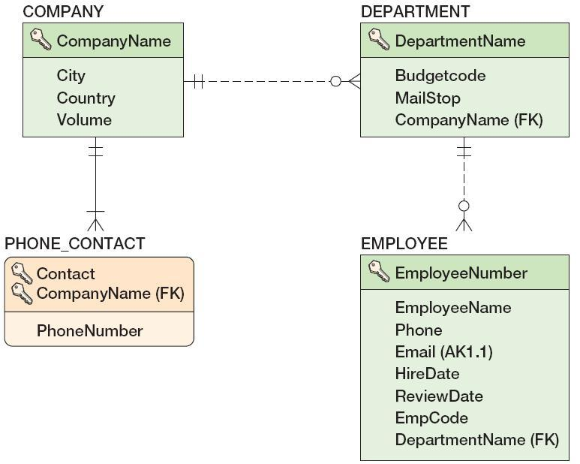
Documenting the Minimum Cardinality Design: Documenting Required Parents
COMPANY is parent, DEPARTMENT is child.
The relationship is M-O.
This can often be done in the database design tools.

Slide 62
Documenting the Minimum Cardinality Design: Documenting Required Children
Needs written documentation
Can use Figure 6-2b(b) as a “boilerplate document” and fill it out for each specific situation

Slide 63
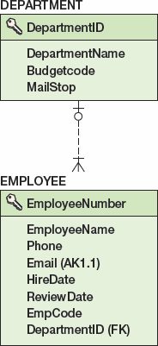
Documenting the Minimum Cardinality Design: Documenting Required Children
DEPARTMENT is parent, EMPLOYEE is child.
The relationship is O-M.
Use documentation based on Figure 6-28(b)—see the next slide.

Slide 64
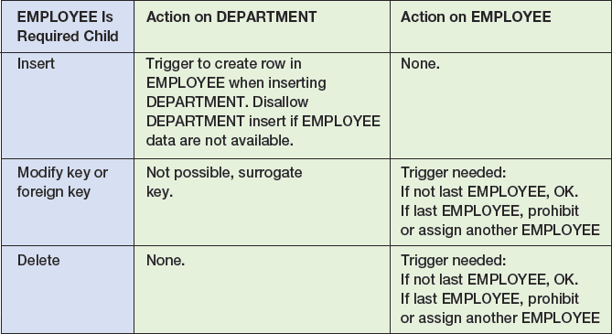
Documenting the Minimum Cardinality Design: Documenting Required Children

Slide 65
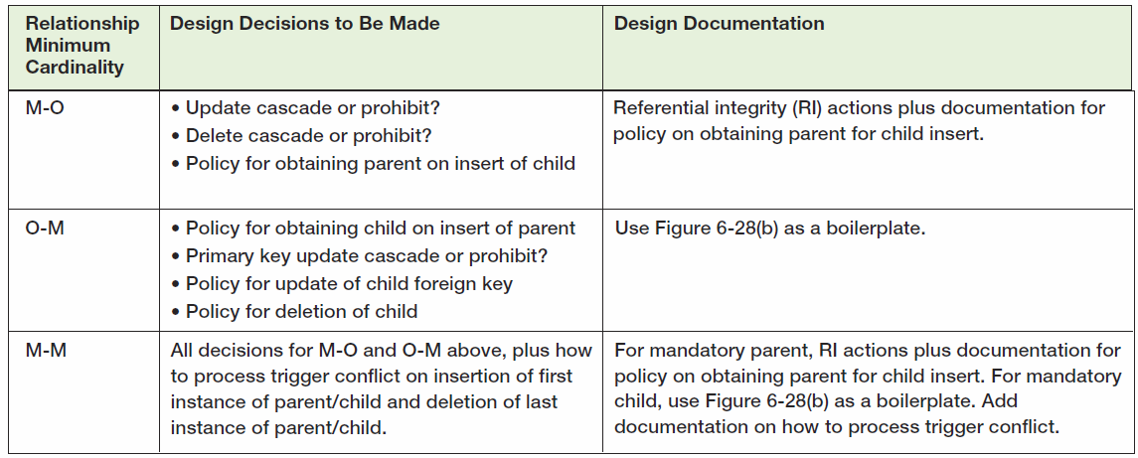
Summary of Minimum Cardinality Design

Slide 66
View Ridge Gallery
View Ridge Gallery is a small art gallery that has been in business for 30 years.
It sells contemporary European and North American fine art.
View Ridge has one owner, three salespeople, and two workers.
View Ridge owns all of the art that it sells; it holds no items on a consignment basis.

Slide 67
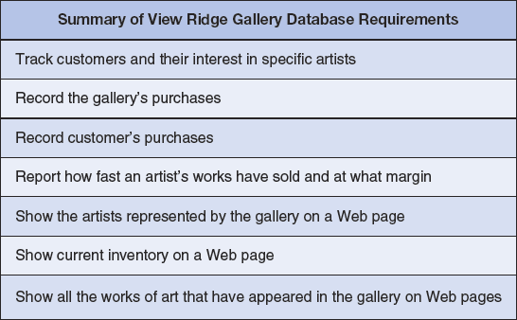
VRG Application Requirements

Slide 68
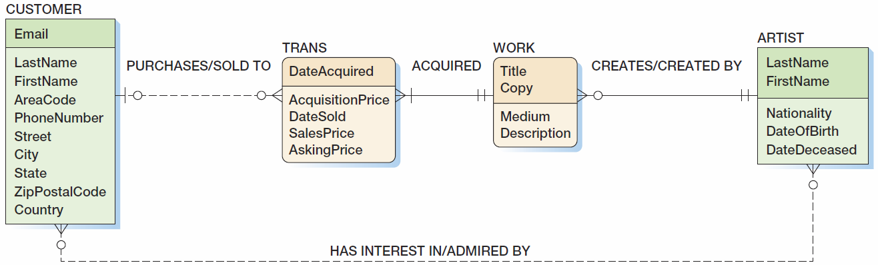
View Ridge Data Model

Slide 69
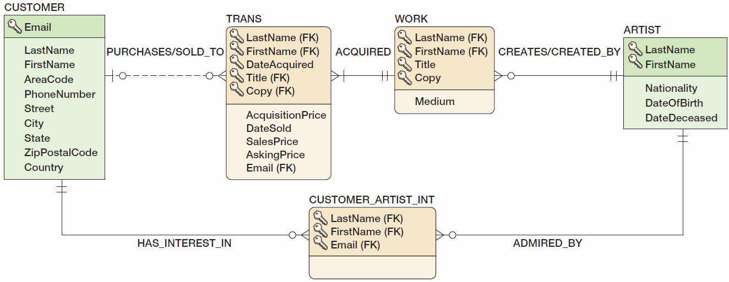
View Ridge Database Design 1
Notes:
- Email이 없는 고객 존재 가능
- Trans, Work의 경우 기본 키가 너무 큼.

Slide 70
View Ridge Database Design
Surrogate keys are needed for:
CUSTOMER
WORK
TRANS
We can also use a surrogate key for ARTIST.
This will change the identifying relationships to nonidentifying relationships.
WORK and TRANS become weak, non-ID-dependent entities.
Foreign keys:
TRANS.CustomerID is NULL to allow acquisitions without an immediate sale to a CUSTOMER.
All other foreign keys are NOT NULL.

Slide 71
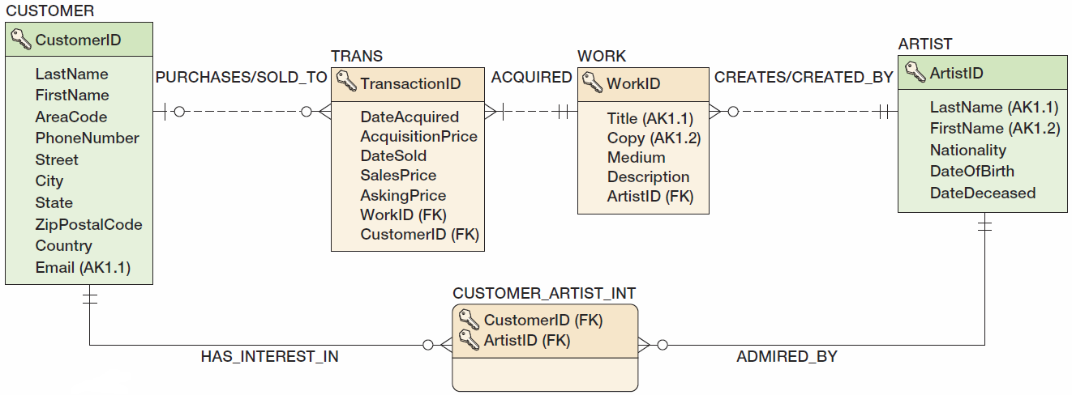
View Ridge Database Design 2

Slide 72
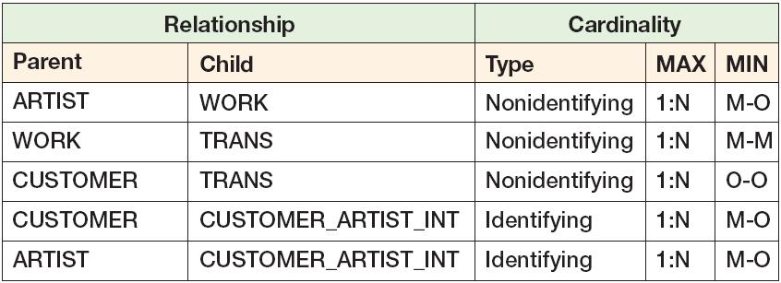
Minimum Cardinality Enforcement: View Ridge Relationships

Slide 73
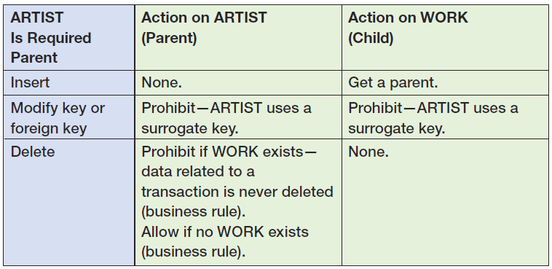
Minimum Cardinality Enforcement: View Ridge M-O Relationships ARTIST-to-WORK

Slide 74
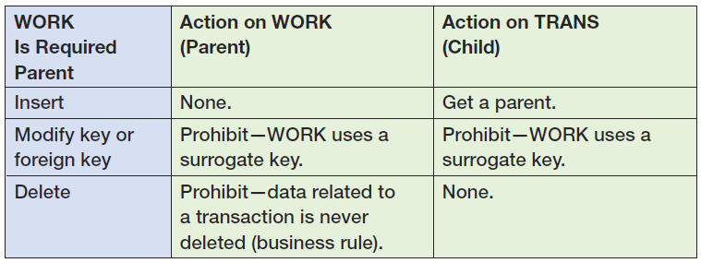
Minimum Cardinality Enforcement: View Ridge M-O Relationships WORK-to-TRANS

Slide 75

Minimum Cardinality Enforcement: View Ridge M-O Relationships CUSTOMER-to-CUSTOMER_ARTIST_INT

Slide 76

Minimum Cardinality Enforcement: View Ridge M-O Relationships ARTIST-to-CUSTOMER_ARTIST_INT

Slide 77

Minimum Cardinality Enforcement: View Ridge M-M Relationships

Slide 78

View Ridge Table Designs: ARTIST

Slide 79

View Ridge Table Designs: WORK

Slide 80

View Ridge Table Designs: TRANS

Slide 81

View Ridge Table Designs: CUSTOMER

Slide 82

View Ridge Table Designs: CUSTOMER_ARTIST_INT

Slide 83
David Kroenke and David Auer Database Processing Fundamentals, Design, and Implementation (13th Edition)
End of Presentation:
Chapter Six

Slide 84

All rights reserved. No part of this publication may be reproduced, stored in a retrieval system, or transmitted, in any form or by any means, electronic, mechanical, photocopying, recording, or otherwise, without the prior written permission of the publisher. Printed in the United States of America.

